Slide 1



SMTP Protocol Team Presentation: Khafuq Altheyab Raghad Alshalan Wafaa Alkhamis

Slide 2

Outline
Application Layer
What is SMTP?
How is it work?
SMTP Response Code
Mail Transfer Phases
Connection Establishment
Mail transfer
Connection termination
Characteristics of STMP
Advantages and Disadvantages
Examples of SMTP

Slide 3
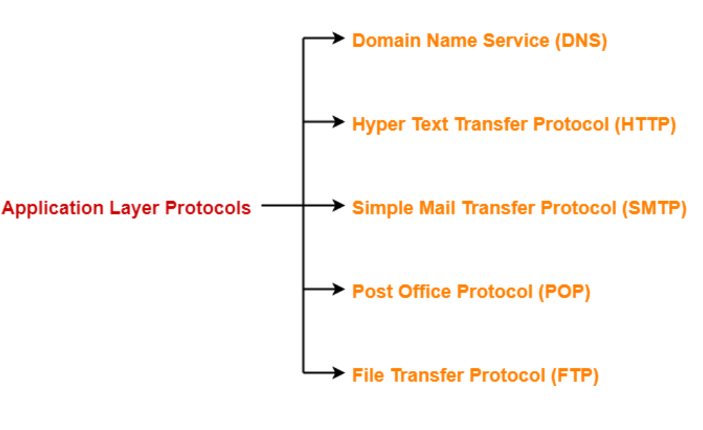
Application Layer

Slide 4
What is SMTP?
SMTP stands for Simple Mail Transfer Protocol.
SMTP is a relatively simple, text-based protocol, where one or more recipients of a message are specified and then the message text is transferred.
SMTP is used to send and receive email. It is sometimes paired with IMAP or POP3 (for example, by a user-level application), which handles the retrieval of messages, while SMTP primarily sends messages to a server for forwarding.

Slide 5
How is it work?
SMTP server is always on a listening mode.
Client initiates a TCP connection with the SMTP server.
SMTP server listens for a connection and initiates a connection on that port.
The connection is established.
Client informs the SMTP server that it would like to send a mail.
Assuming the server is OK, client sends the mail to its mail server.
Client’s mail server use DNS to get the IP Address of receiver’s mail server.
Then, SMTP transfers the mail from sender’s mail server to the receiver’s mail server.

Slide 6
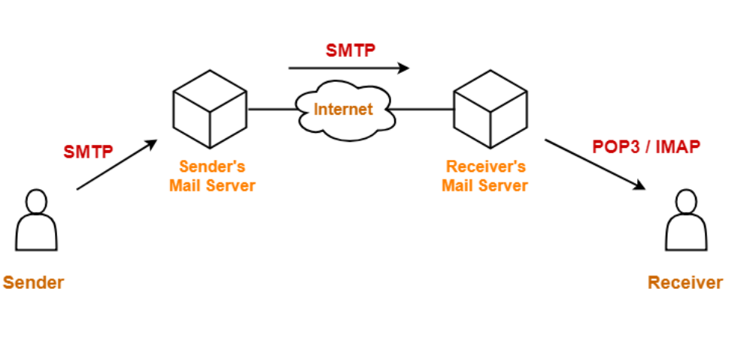

Slide 7
SMTP Response Code
Responses are 3-digit codes sent from server to client
220: The SMTP service is ready
250: The command has been completed
354: OK to transmit message
450: Command can not be completed because the mailbox is busy
221: SMTP is closing the transmission channel
451: Command has been aborted because of an error
452: Command has been aborted because the receiving host is out of disk space
500: Syntax error
550: Specified mailbox is unavailable or does not exist
552: Command was aborted because the recipient has exceeded their storage quota
554: The transaction has failed

Slide 8
Mail Transfer Phases
Connection Establishment
Mail transfer
Connection termination

Slide 9
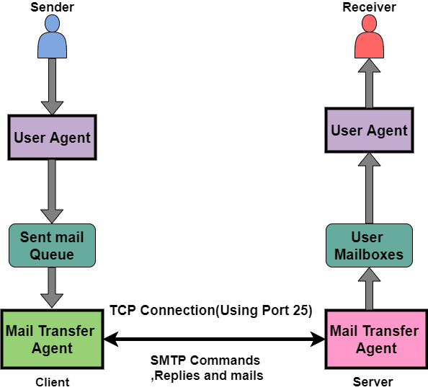

Slide 10
Connection Establishment
An SMTP sender will attempt to set up a TCP connection with a target host when it has one or more mail message to deliver to that host. The following sequence occurs during connection setup:
The sender opens a TCP connection with the receiver.
Once the connection is established, the receiver identifies itself with '220 Service Ready".
The sender identifies itself with the HELO command.
The receiver accepts the sender's identification with "250 'OK".
If the mail service on the destination is not available, the destination host returns a "421 Service Not Available" reply in step 2 and the process is terminated.

Slide 11
Mail transfer
Once the connection has been established, the SMTP sender may send one or more messages to the SMTP receiver. There are three logical phases to the transfer of a message :
A MAIL command identifies the originator of the message.
One or more RCPT commands identify the recipients of this message.
A DATA command transfers the message text.

Slide 12
Connection Termination
The SMTP sender closes the connection in the following manner:
The sender sends a QUIT command and waits for a reply.
Sender initiates TCP close operation for the TCP connection.
The receiver initiates its TCP close after sending is reply to the QUIT command.

Slide 13
Characteristics of STMP
SMTP is a push protocol.
SMTP uses TCP at the transport layer.
SMTP uses port number 25.
SMTP uses persistent TCP connections, so it can send multiple emails at once.
SMTP is a connection-oriented protocol.
SMTP is an in-band protocol.
SMTP is a stateless protocol.

Slide 14
Advantages and Disadvantages
Advantages of SMTP
SMTP offers reliability in terms of the outgoing email messages.
It is the simplest form of communication between various computers in a network via Email.
In those cases where a particular message was not delivered successfully then, the SMTP server always tries to re-send the same message until the transmission becomes successful.
Disadvantages of SMTP
SMTP does not provide good security.
It is only limited to 7-bit ASCII characters.
Beyond some specific length, email messages are rejected by SMTP servers.
The usefulness of SMTP is limited by its simplicity.
With the help of SMTP, the transmission of executable files and binary files is not possible until they get converted into text files.

Slide 15
Examples of SMTP
Offer of the day
Live data
Limited time content
Social content

Slide 16
Thank you for listening
z

